Slide 1
2D Fluid Dynamics Simulator -TechGeeks
Final Presentation
Michael Chase Bonifant
Naga Sindhu Kannekanti
Srikanth Bitla
Ayman Almusalam
Sai Krishna Kalakonda

Slide 2
Architecture Diagram

Slide 3
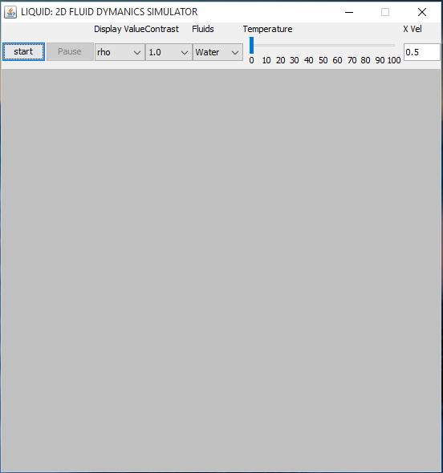
Main Screen

Slide 4
Features
Temperature Control
Barriers
Contrast
Fluid Values
Obstacle Selection

Slide 5
Features Partially Completed /Implemented
Log Handling
User Interface as per SRS
Replay of Simulation

Slide 6
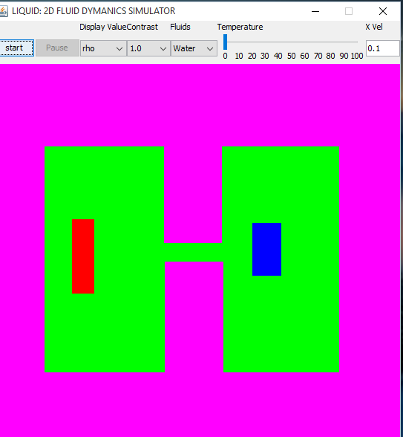
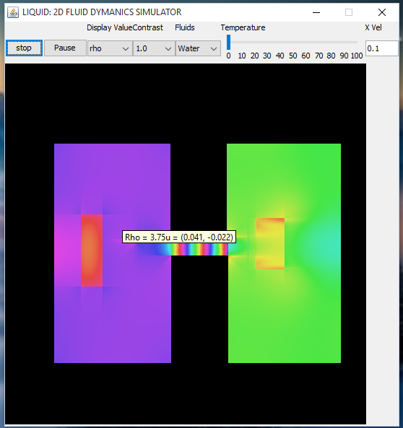
Screen when Simulation is running

Slide 7
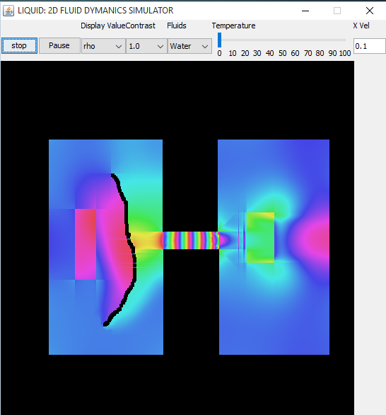
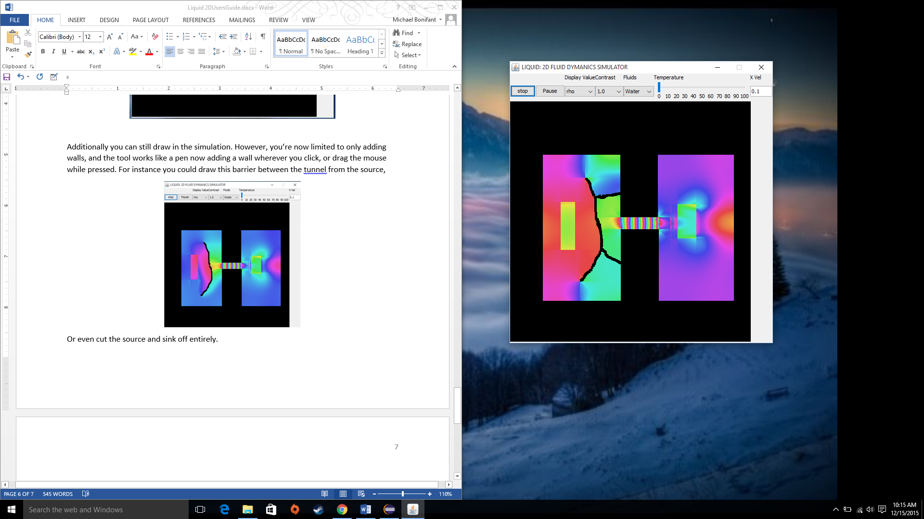
Simulation Follows

Slide 8
Tools Used
Editplus & Sublime & Eclipse (IDE)
Asana (project management)
Revisions (GitHub)
Revision Client tool (SmartGit)
Microsoft Office

Slide 9
Demo Follows…

Slide 10
Thank You

